Slide 1

Indian Law Information Chatbot
Based on Llama Index & ChatGPT
Piyush Dubey | Team - Innovate

Slide 2
What are we working on
Creating Custom Knowledge based bots
Dataset is Given to the model to train GPT on the top of it

Slide 3
About the project
The Law Information ChatBot is designed to assist users in retrieving relevant information about legal sections and information about it. It utilises the Indian Penal Code (IPC) and Code of Criminal Procedure (CRPC) as dataset on which chatgpt is trained. It combines the power of Llama Index, a dataset indexing library, and ChatGpt, a language model, to create an interactive conversational experience.
The project repository contains the necessary code and resources to run the ChatBot. Additionally, the dataset used for indexing is also provided.

Slide 4
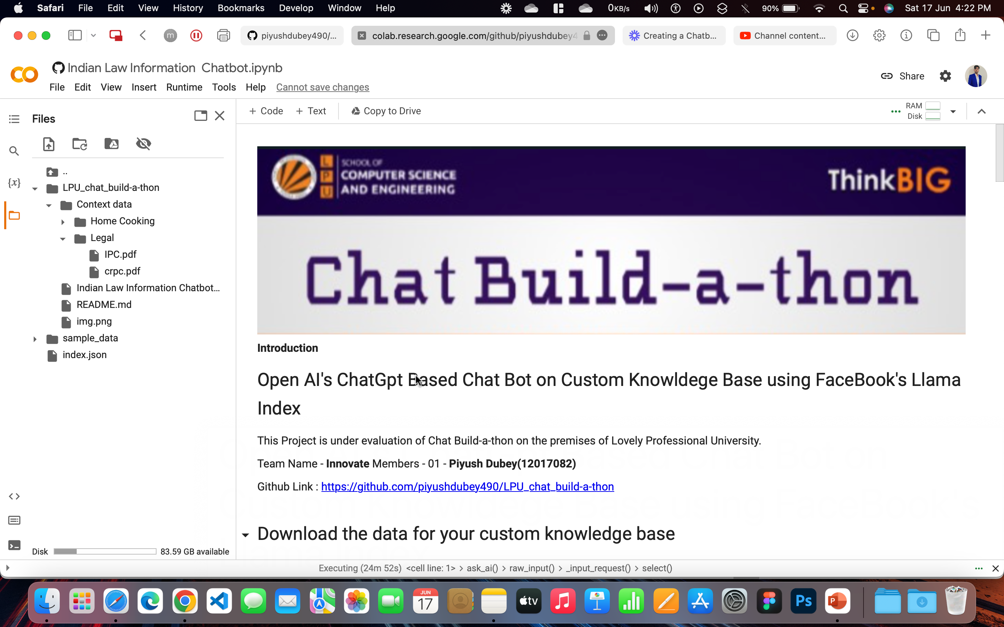
1.

Slide 5
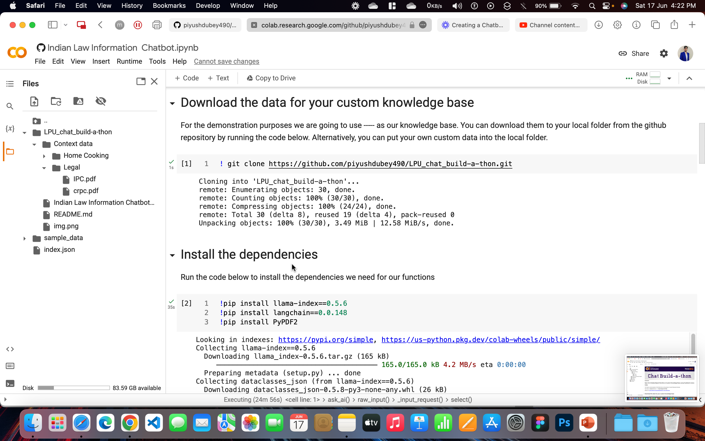
2.

Slide 6
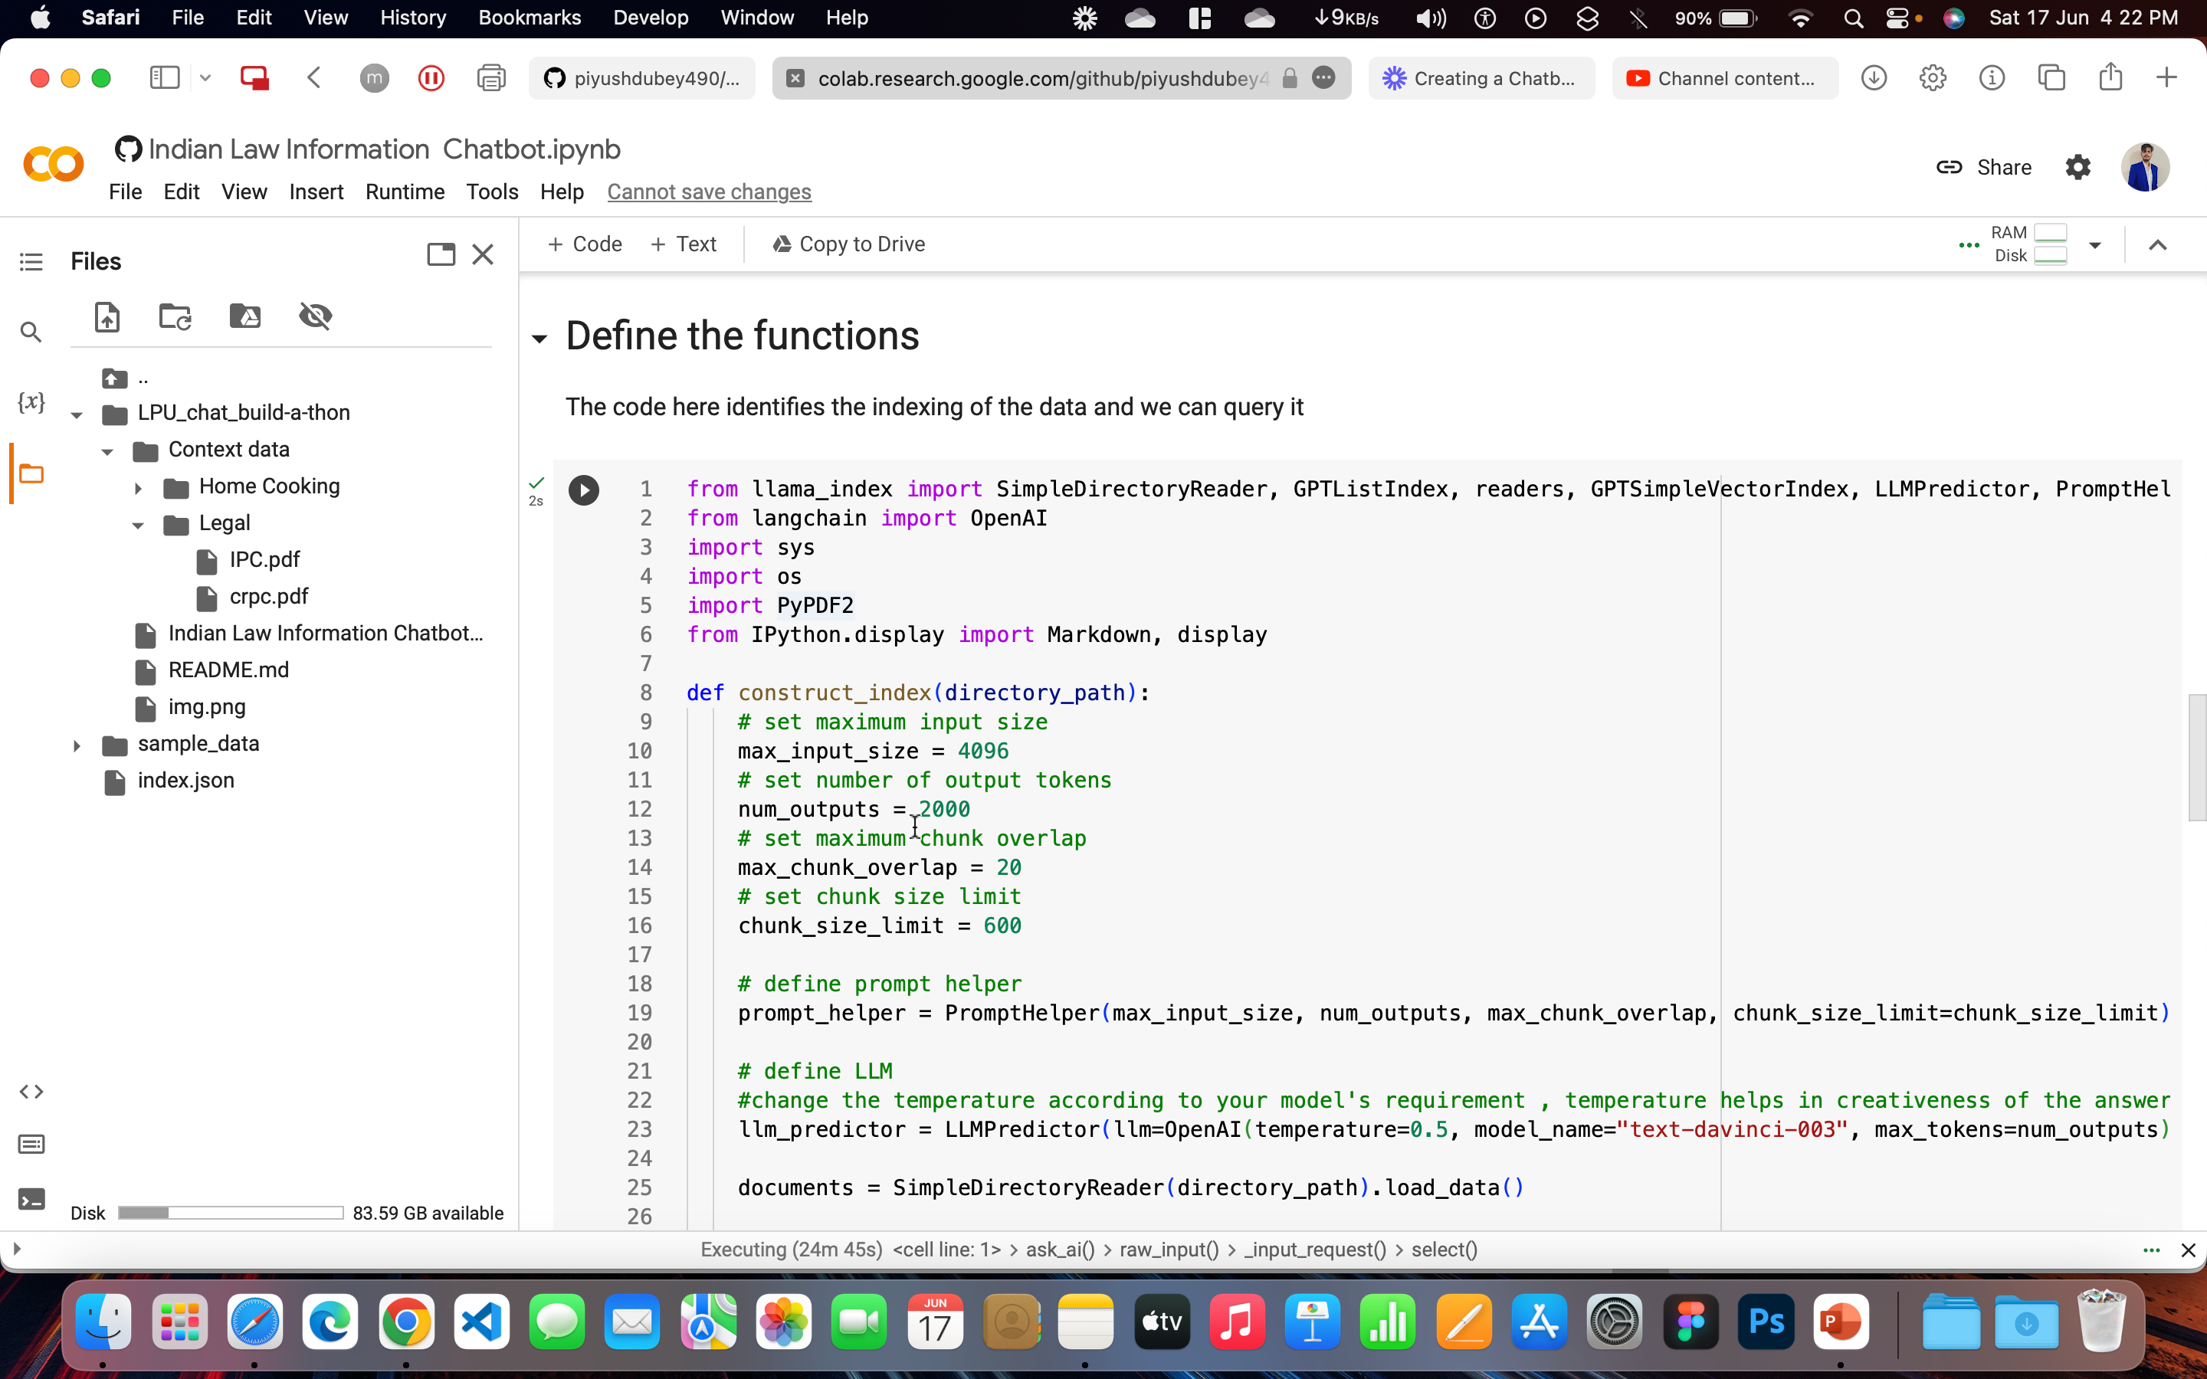
3.

Slide 7
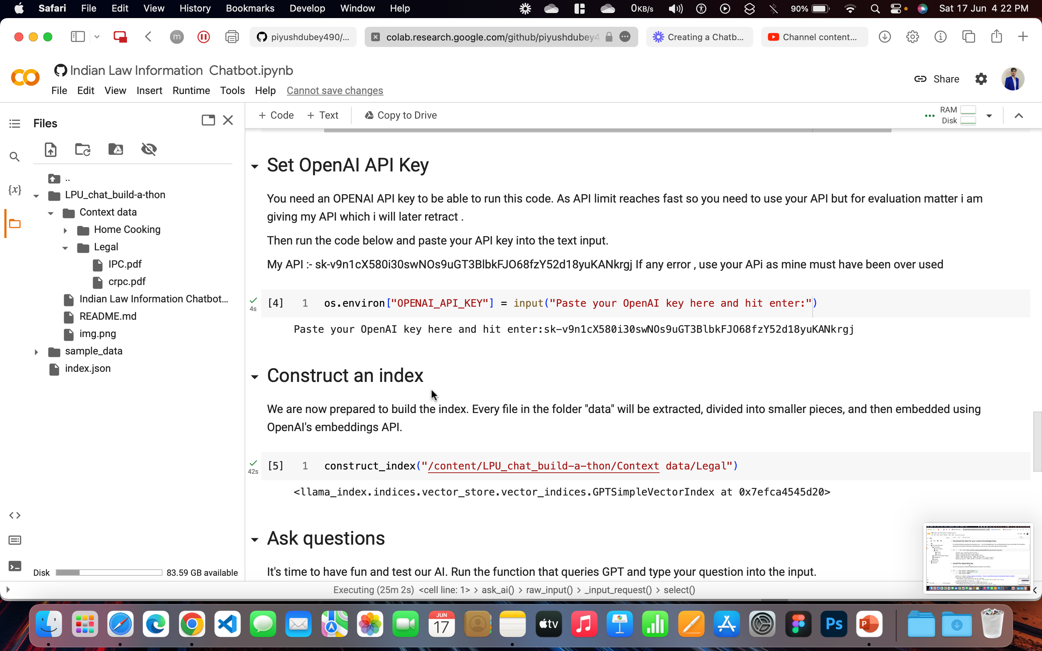
4.

Slide 8
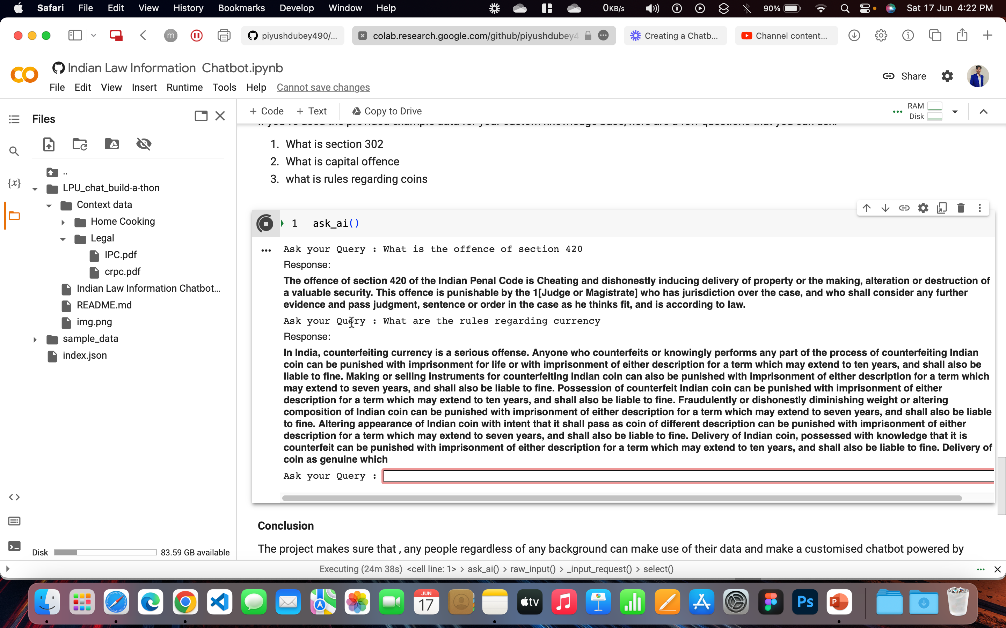
5.

Slide 9
SOCIETY BENEFITS
It provides easy access to legal information, empowering individuals to understand their rights and responsibilities.
The chatbot simplifies legal concepts, making them more understandable for non-legal professionals.
It offers guidance on legal procedures, helping individuals navigate processes such as filing complaints or applying for licenses.
The chatbot raises awareness about legal rights and obligations, promoting a more informed and empowered society.
It assists legal professionals by providing quick access to legal resources and saving time in research.
The chatbot promotes legal literacy, enabling individuals to make informed decisions and actively participate in legal discussions.
However, it is important to remember that the chatbot is not a substitute for professional legal advice, and consulting a qualified lawyer is recommended for specific legal matters.

Slide 10
THANKS

